Slide 1
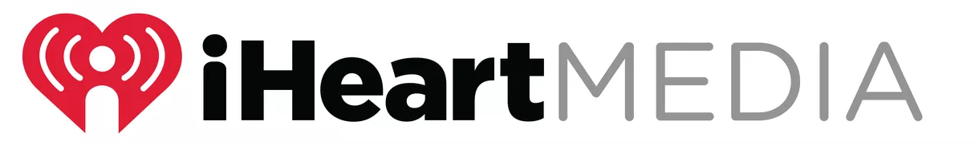



My summer internship with
Zoë Zimmerman ‘16
Communications

Slide 2
What was my internship, exactly?
This summer, I completed my second internship with iHeartMedia. As opposed to last summer, where I worked in New York City in the corporate office as a Communications and Marketing Intern, this summer I worked in Medford, MA as a Marketing and Promotions intern for my local radio stations, KISS 108, JAM’N 94.5, and 101.7 The Bull.

Slide 3
Responsibilities
I assisted the Promotions department in:
Effectively and efficiently executing events.
Executing promotional elements and initiatives online and on-air.
  Posting events and contests on the station’s website.
    Processing contest winners by calling individuals and arranging prize pick-up.
  Promoting the stations through social media.

Slide 4
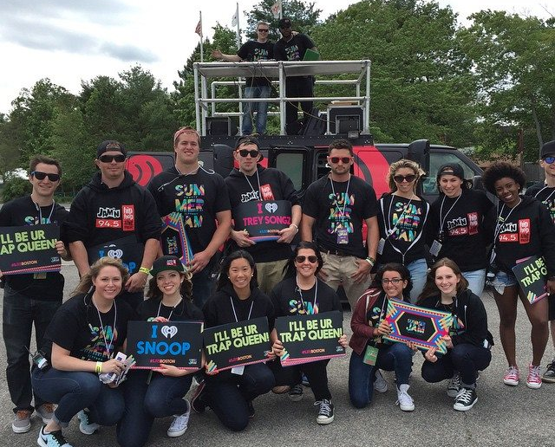
1. Summer Jam
I practiced a lot of face-to-face communication, as this was very customer service based. It was important that my job was done well, for I was representing JAM.N 94.5 that day.
Summer Jam is a one-day, outdoor concert in Mansfield, MA, that brings together a diverse array of hip-hop artists at the beginning of summer. My job was in the pressroom, processing VIP guests for media promotions.
ME!

Slide 5
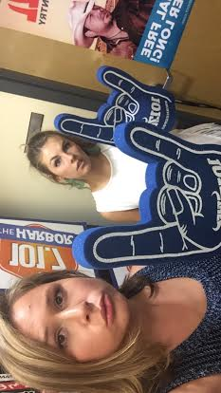
Other events
All three stations, KISS 108, JAM’N 94.5, and 101.7 The Bull, make appearances at all different types of events. Whether it be a charity, movie screening, or just a night at a local bar, if the station attends, those working on the Street Team play games and hand out free merchandise to promote the station. To prepare them for these events, I prepped bins. Basically, I gathered up a bunch of station merchandise that was relevant to the event/audience, for example, stickers, pins, foam hands, and tee shirts, and then I sent them on their way!
#HornsUpBoston

Slide 6
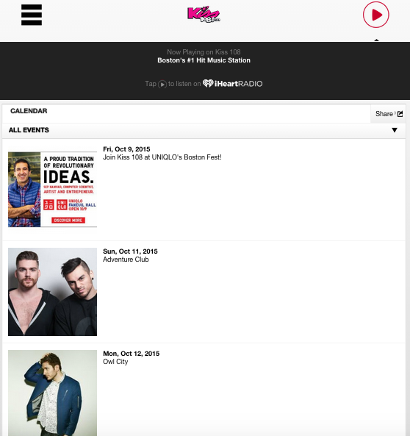
Updating the Calendar online

Slide 7
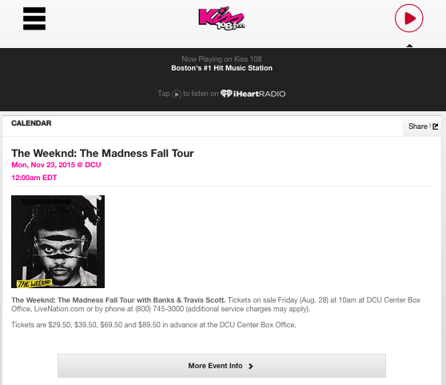
Adding events & concerts to the calendar
Adding an event or a concert to the calendar was actually a pretty difficult task. It took learning how to code, which I had never tried before. It was a bit of a process in which the event/concert would have to be made private until approved, and then I would go back in, and edit it so that it could be seen to the public.

Slide 8
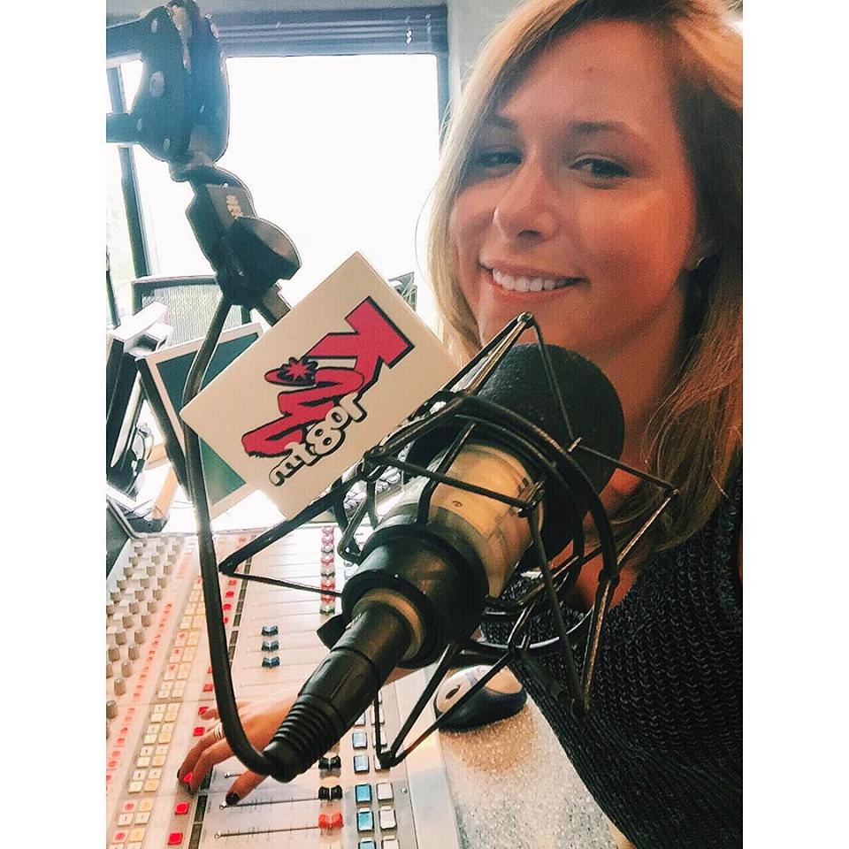
2. That time I went on air….well…kind of.
As a part of the internship program, I had an opportunity to shadow the jocks on-air upstairs live in our studios. My role was answering phone calls for song requests and picking winners for big concerts like Taylor Swift. There’s me in the studio!

Slide 9
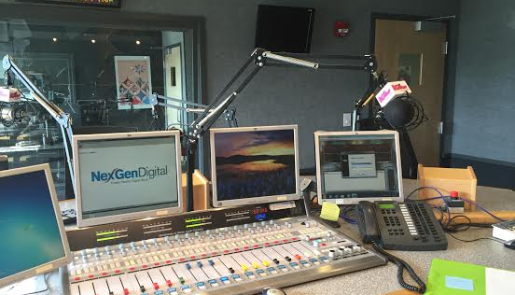
Sitting in the kiss studio with Romeo

Slide 10
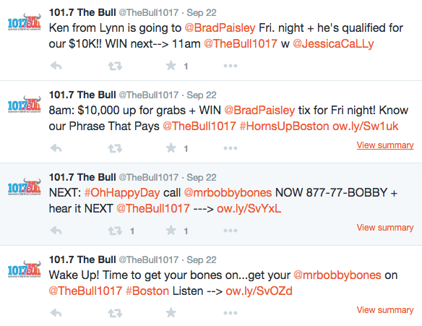
Social Media
I pre-posted promotional tweets to have them go off at multiple times during the day. I made sure to use promotional hashtags and tags as often as possible.
#HornsUpBoston
@TheBull1017
*these are not my tweets, just examples

Slide 11
Strengths
Customer Service Skills
  On the phone
  Explaining paper work
  At events
Organization
  There were so many file cabinets filled with winner sheets. It was important to stay organized to make sure that no winner got lost!
Time Management
  Many projects I worked on had time constraints, especially contest and event postings. It was important to get the post, which took time to make, up in a timely manner in order for it to reach the public at the intended time.

Slide 12
Weaknesses
The job did not involve a lot of team work, and I definitely thrive in team environments. I think projects where collaboration was involved would have been better for me.
A lot of the tasks and responsibilities I had to figure out on my own. For example, I was never taught how to do the coding to post the calendar events. I had a very hard time figuring it out for myself, probably because I have never had any experience with coding.

Slide 13
Take away’s
After completing two different internships within iHeartMedia, I have been able to identify where my passions lie. Though this summer’s internship was not particularly my favorite, I believe that working at a different level of iHeartMedia gave me the opportunity to see how the company operates as a whole. Working this internship made me feel as though I was not doing enough to make a significant impact on the world, which is something I hope to do in the future. I was definitely making customers happy, but as I worked this position, I was able to identify how much more I preferred my previous internship, where I worked on charity campaigns, drafted press releases and op-eds, and really put my brain to use. I have acquired many skills as a communication major at Cornell and I aim to put them to use in my future career!

