Slide 1
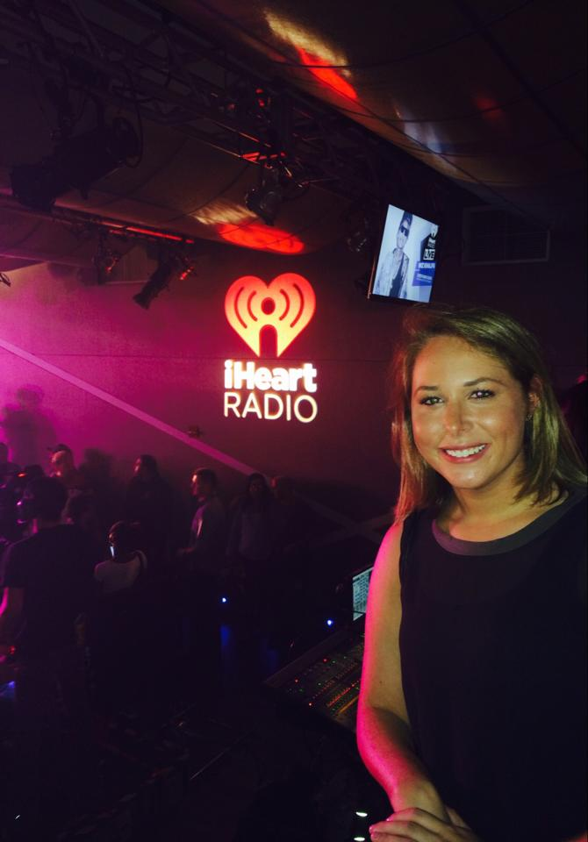


Communication/Marketing Internship
By: Zoë Zimmerman

Slide 2
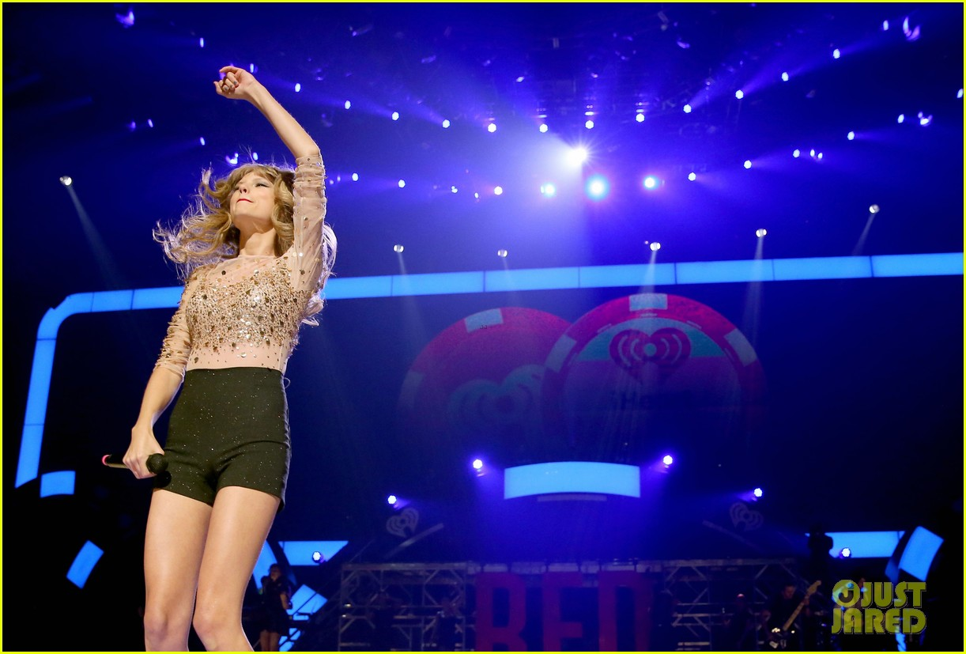
My internship at Clear Channel was more than I could have ever dreamed of. Never having completed an internship before, I wasn’t sure exactly what I was walking into, though, there was never a moment prior to the internship that I had doubts. I knew I was going to be in for a pretty good summer, working in the field I am seeking to enter consequent to my graduation. Little did I know that I was going to have the summer of a life time.

Slide 3
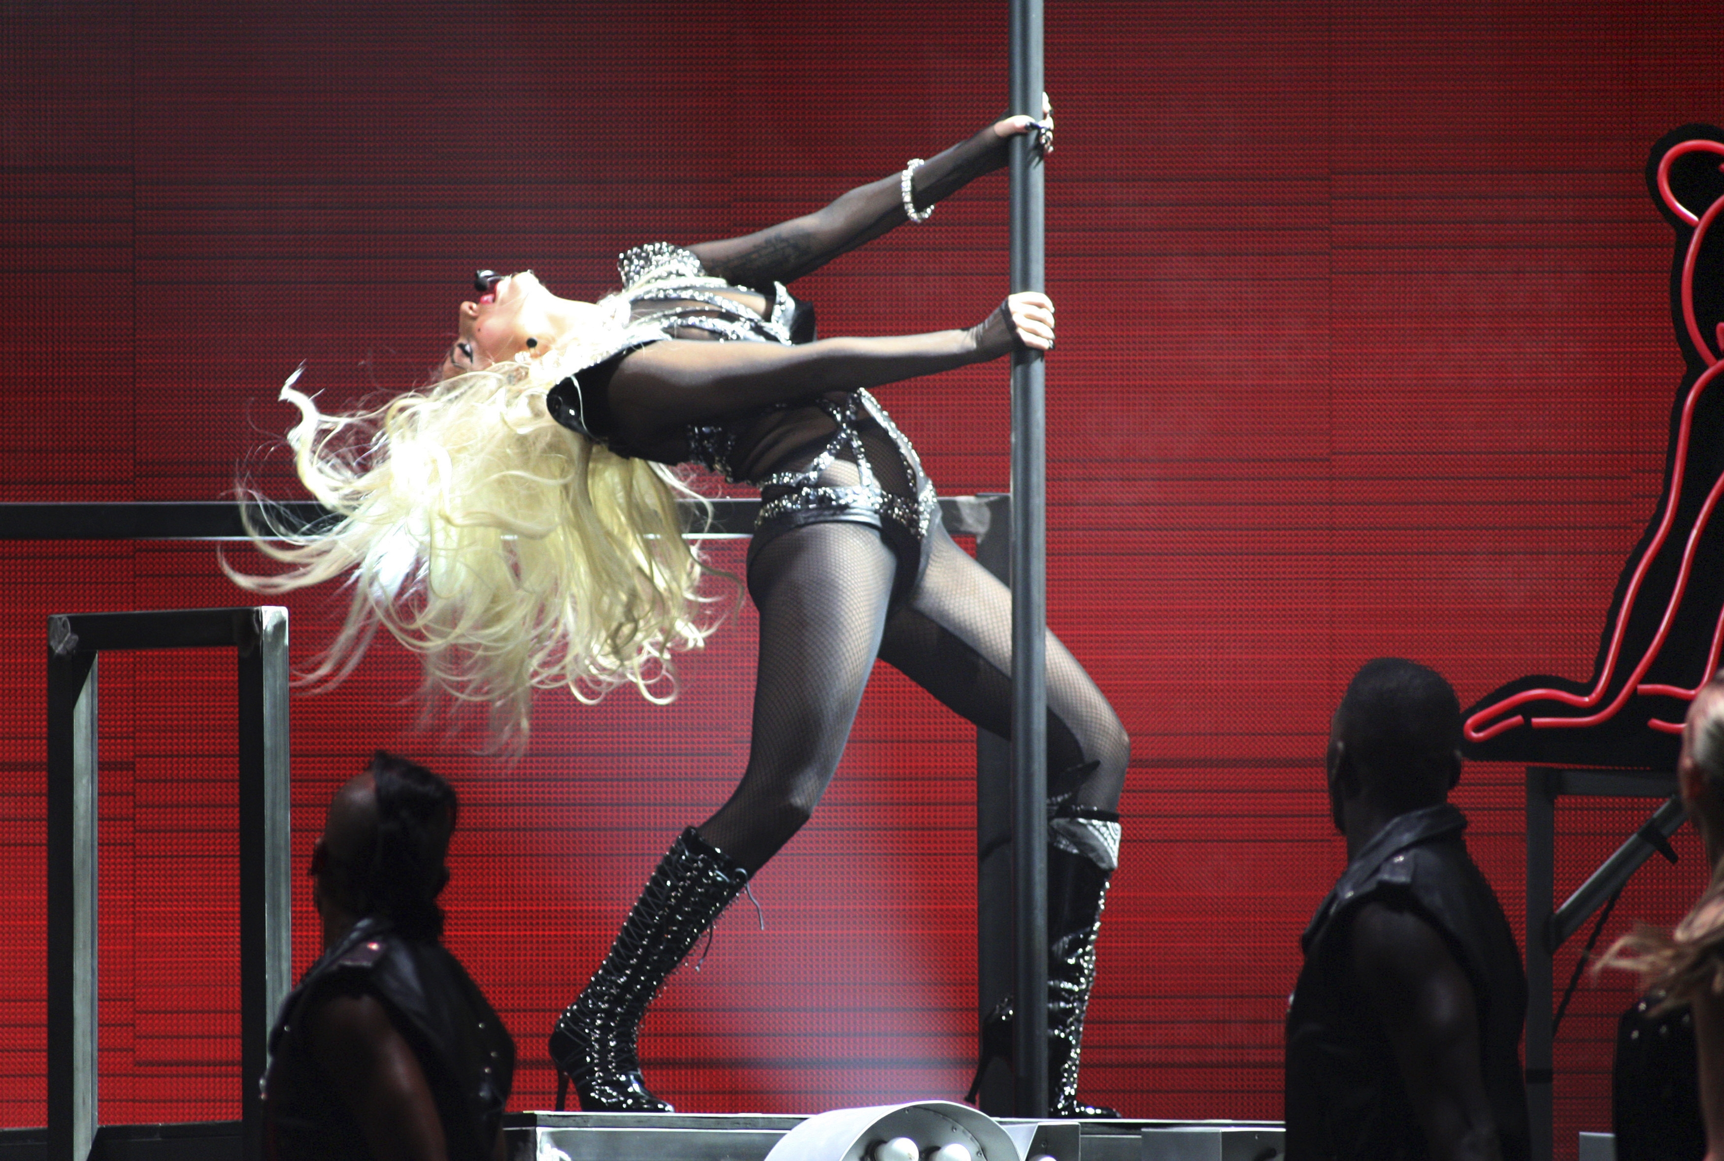
Here are some of the tasks that kept me busy...

Slide 4


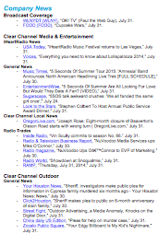
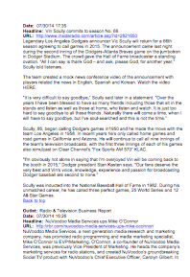
MEDIA MONITORING. I Assisted with Clear Channel Communities in creating a template for a quarterly newsletter that is distributed throughout the company daily.
Everyday, using Meltwater, an online media intelligence service, I archived articles that mentioned keywords such as Clear Channel, iHeartRadio, Bob Pittman (CEO), Jingle Ball, CCME, along with some others. I then organized them into the different divisions of Clear Channel, Clear Channel Media + Entertainment and Clear Channel Outdoor. From there, I organized the articles under broadcasts, corporate news, general news, local news, and also added a competitive landscape category in which I would include articles about Spotify, Pandora, CBS, etc. I would make a full report including the outlet, date, headline, URL, and text of the article. It would be sent out the company-wide the following day.

Slide 5
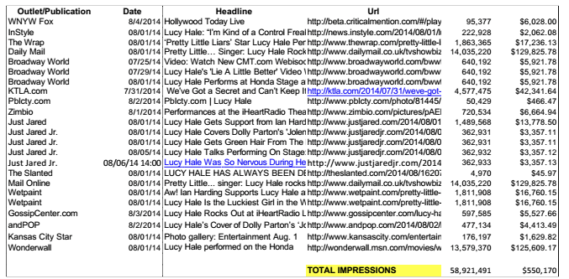
I assisted with compiling MEDIA REPORTS for various Clear
Channel events with a focus on estimating total impressions and publicity values.

Slide 6
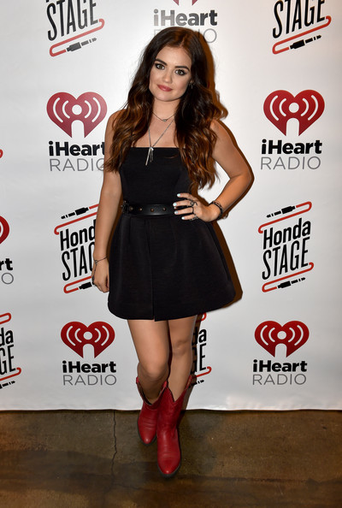
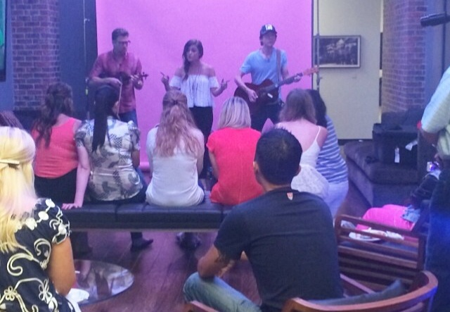
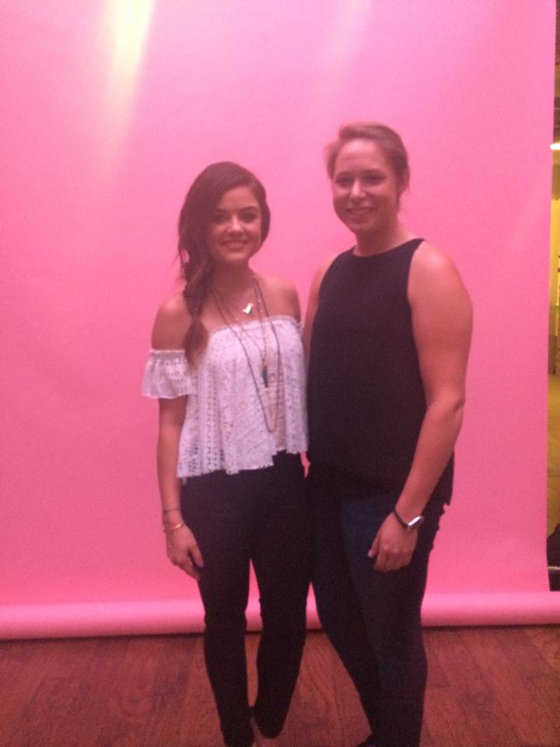
After any big Clear Channel or iHeartRadio event, I created MEDIA REPORTS to estimate total impressions. The previous slide features a report of articles featuring Lucy Hale after she took the Honda Stage at the iHeartRadio Theater this summer. When creating media reports, I made a report similar to that of the daily news, as well as an excel report. On excel, I noted the circulation of the outlet, which I received from Cision, and from there, used a formula to create the publicity value. Then, I’d total it up to get the total impressions from that event.

Slide 7
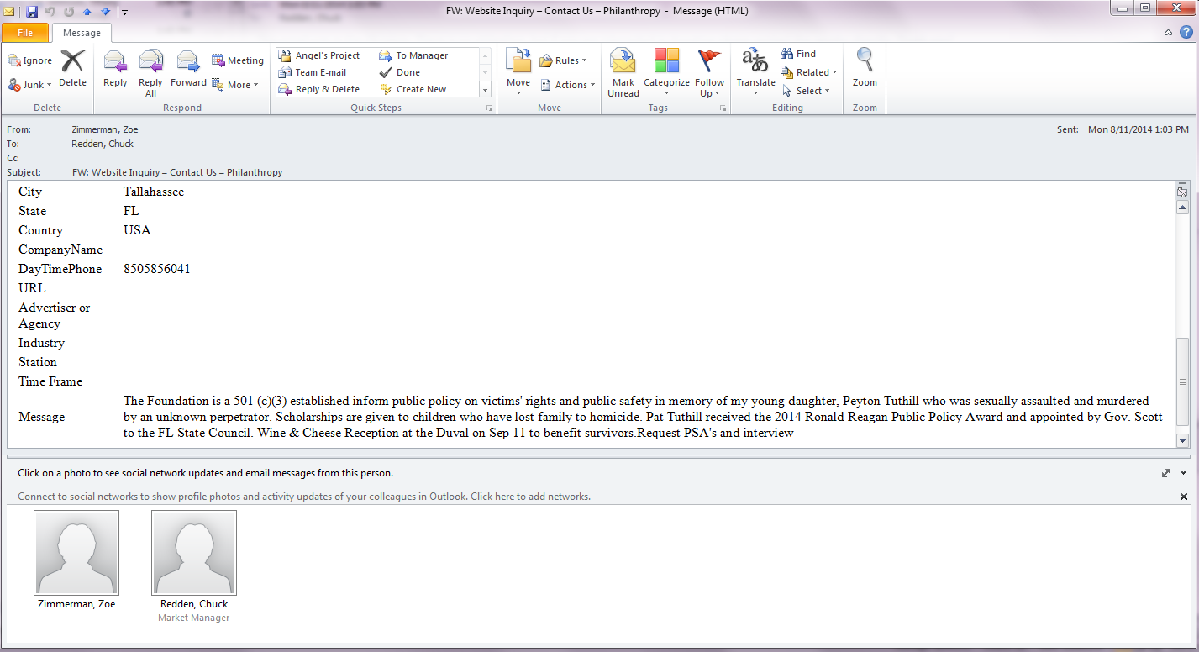
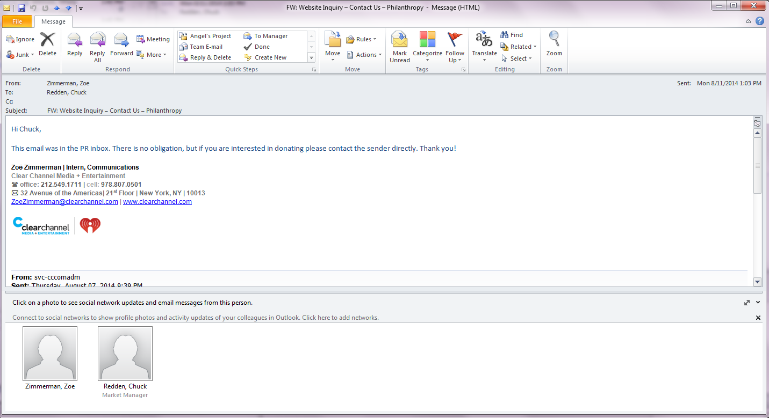
I responded to PR inbox inquiries by reaching out to local markets.
Hi Chuck, This email was in the PR inbox. There is no obligation, but if you are interested please contact the sender directly. Thanks!

Slide 8
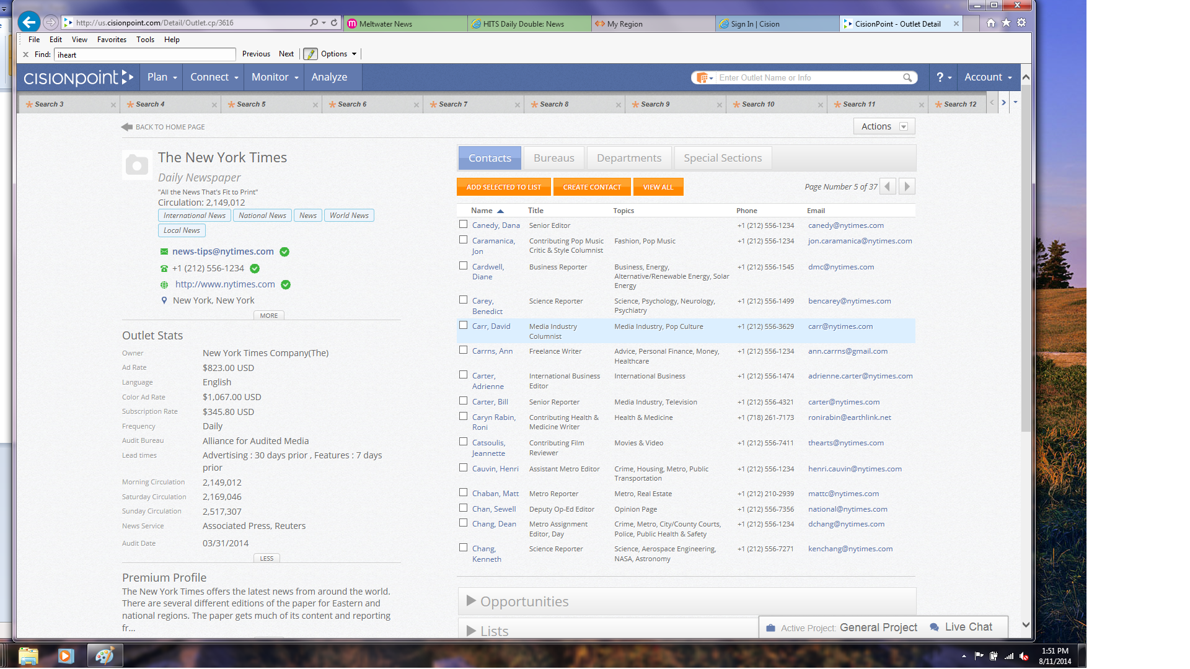
I searched Cision to find updated information on media contacts….

Slide 9
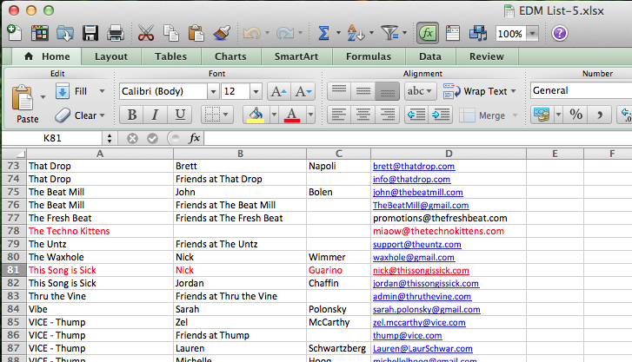
…which I then used to help create mailing lists needed for various events.
EDM CONTACTS

Slide 10

I helped write a Q&A for RYAN SEACREST
Ryan… can you tell me about a Veteran who has had an impact on your life?
  (personal response)
What is the iHeart Radio Show Your Stripes Campaign all about?
  iHeartRadio’s Show Your Stripes is a community initiative launched by Clear Channel, to generate awareness around the issue of veteran unemployment, encourage businesses to hire skilled veterans, and help those transitioning out of the military find jobs.
  With over $75 million in radio, digital and out-of-home resources dedicated to this initiative in just one year, iHeartRadio’s Show Your Stripes is the single largest public service campaign in Clear Channel’s history.
How can a potential employer learn more about hiring vets?
  A potential employer can learn more about hiring vets by reading up on iHeartRadio’s showyourstripes.org.
  Employers have the opportunity to post jobs specifically geared toward veterans because of the partnership between iHeartRadio’s Show Your Stripes, Military.com, and Monster.
  With its partnership with Military.com and Monster, Show Your Stripes offers vets access to 70,000 military friendly jobs and businesses.
………

Slide 11
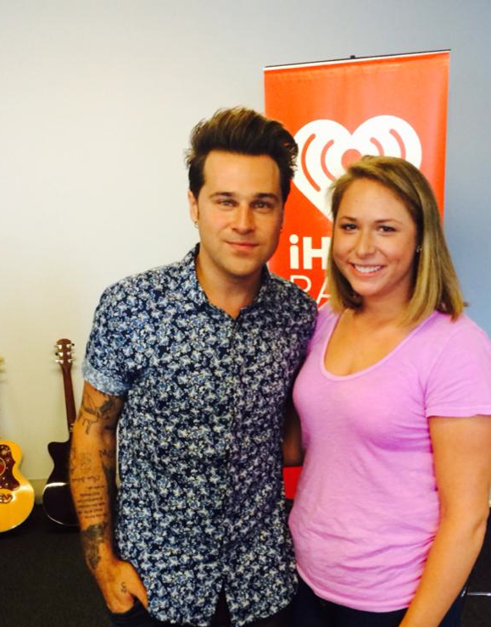

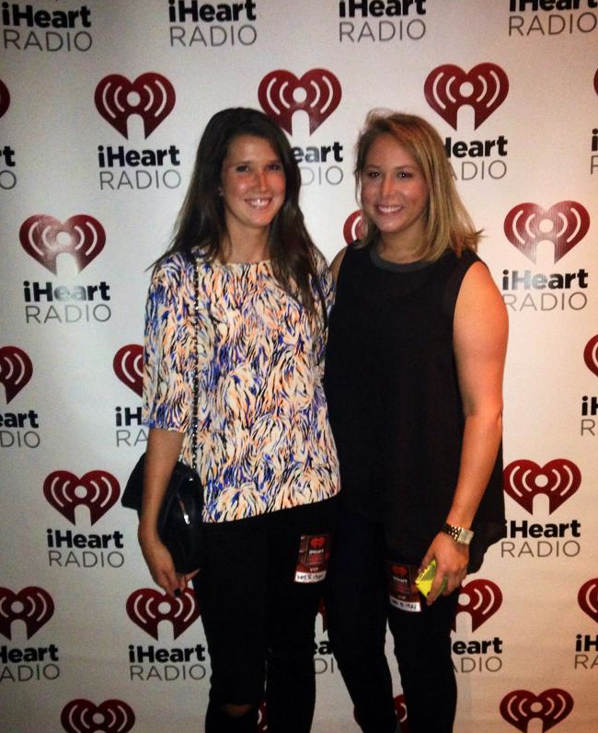
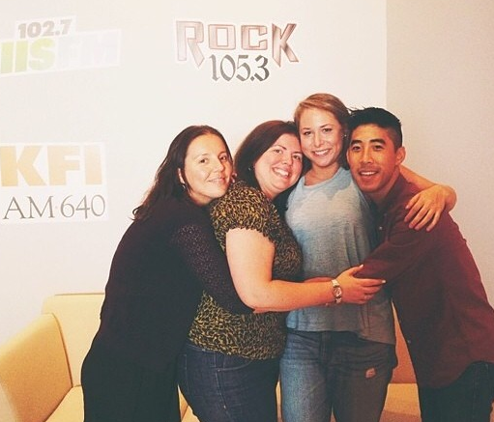
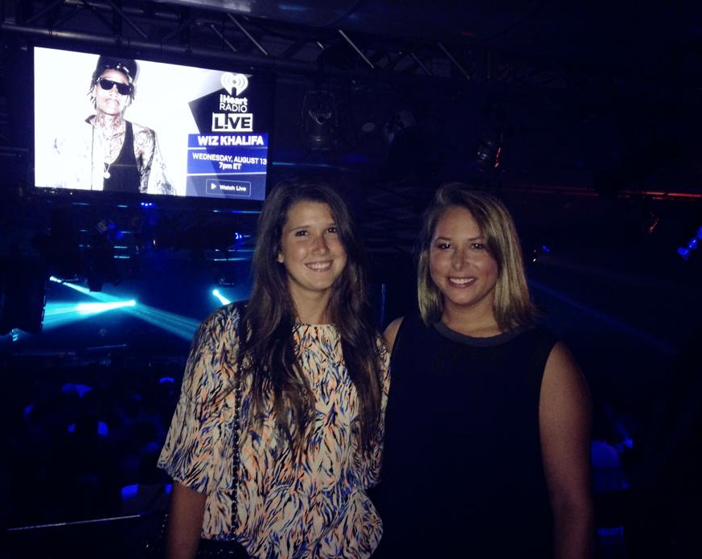
And I had the opportunity to see some great musical performances!

Slide 12
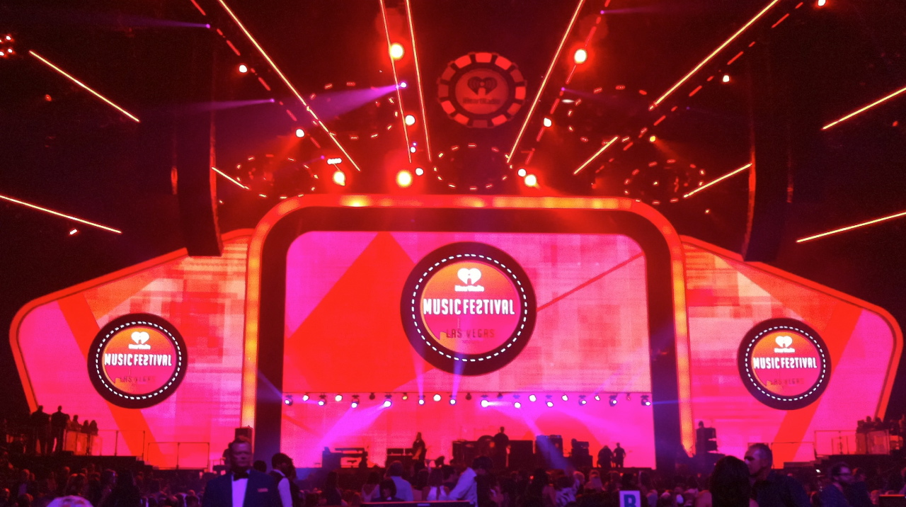
I was fortunate enough to have been given the opportunity to intern at Clear Channel this summer. An office that awaited me with an incredible team ready to answer my questions (which there were many of) and teach me about all the different aspects of the media industry was most definitely a reason to get up everyday.

